Slide 1


Slide 2
1 The Mathematics of Voting
1.1 Preference Ballots and Preference Schedules
1.2 The Plurality Method
1.3 The Borda Count Method
1.4 The Plurality-with-Elimination Method (Instant Runoff Voting)
1.5 The Method of Pairwise Comparisons
1.6 Rankings

Slide 3
Plurality Method
Candidate with the most first-place votes (called the plurality candidate) wins
Don’t need each voter to rank the candidates - need only the voter’s first choice
Vast majority of elections for political office in the United States are decided using the plurality method
Many drawbacks - other than its utter simplicity, the plurality method has little else going in its favor

Slide 4
Example 1.2 The Math Club Election (Plurality)
Under plurality:
A gets 14 first-place votes
B gets 4 first-place votes
C gets 11 first-place votes
D gets 8 first-place votes
and the results are clear - A wins (Alisha)

Slide 5
Majority Candidate
The allure of the plurality method lies in its simplicity (voters have little patience for complicated procedures) and in the fact that plurality is a natural extension of the principle of majority rule:
In a democratic election between two candidates, the candidate with a majority (more than half) of the votes should be the winner.

Slide 6
Problem with Majority Candidate
Two candidates: a plurality candidate is also a majority candidate - everything works out well
Three or more candidates: there is no guarantee that there is going to be a majority candidate

Slide 7
Problem with Majority Candidate
In the Math Club election:
majority would require at least 19 first-place votes (out of 37).
Alisha, with 14 first-place votes, had a plurality (more than any other candidate) but was far from being a majority candidate
With many candidates, the percentage of the vote needed to win under plurality can be ridiculously low

Slide 8
Majority Criterion
One of the most basic expectations in a democratic election is the notion that if there is a majority candidate, then that candidate should be the winner of the election.
THE MAJORITY CRITERION
If candidate X has a majority of the first-place votes,then candidate X should be the winner of the election.

Slide 9
Violations
A violation of the majority criterion occurs in an election in which there is a majority candidate but that candidate does not win the election (individual instance).
If this can happen under some voting method, then we say that the voting method itself violates the majority criterion.
Violations can happen, not that they must!

Slide 10
The Condorcet Criterion
The plurality method satisfies the majority criterion-that’s good!
The principal weakness of the plurality method is that it fails to take into consideration a voter’s other preferences beyond first choice and in so doing can lead to some very bad election results. To underscore the point, consider the following example.

Slide 11
Example 1.3 The Marching Band Election
Tasmania State University has a superb marching band. They are so good that this coming bowl season they have invitations to perform at five different bowl games: the Rose Bowl (R), the Hula Bowl (H), the Fiesta Bowl (F), the Orange Bowl (O), and the Sugar Bowl (S). An election is held among the 100 members of the band to decide in which of the five bowl games they will perform. A preference schedule giving the results of the election is shown.

Slide 12
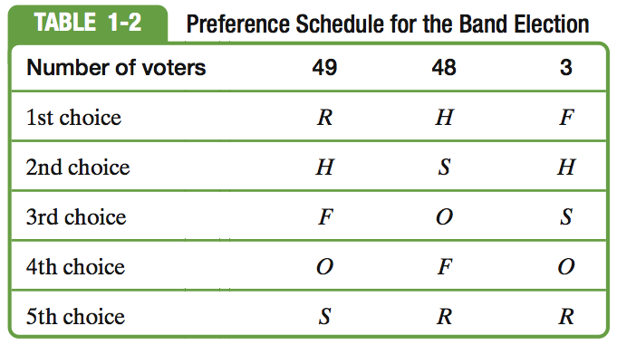
Example 1.3 The Marching Band Election

Slide 13
Example 1.3 The Marching Band Election
Under the plurality method, Rose Bowl wins with 49 first-place votes
Bad outcome - 51 voters have the Rose Bowl as last choice
Hula Bowl has 48 first-place votes and 52 second-place votes
Hula Bowl is a far better choice to represent the wishes of the entire band.

Slide 14
Example 1.3 The Marching Band Election
Compare Hula Bowl to any bowl on a head-to-head basis, it is always preferred:
Hula vs. Rose: 51 (48 + 3) to 49
Hula vs. Fiesta: 97 (4( + 48) to 3
Hula vs. Orange: 100 votes for Hula
Hula vs. Sugar: 100 votes for Hula
No matter which bowl we compare the Hula Bowl with, there is always a majority of the band that prefers the Hula Bowl.

Slide 15
Condorcet Criterion
A candidate preferred by a majority of the voters over every other candidate when the candidates are compared in head-to-head comparisons is called a Condorcet candidate
THE CONDORCET CRITERION
If candidate X is preferred by the voters over each of the other candidates in a head-to-head comparison,then candidate X should be the winner of the election.

Slide 16
Violation of the Condorcet Criterion
Example 1.3 illustrates a violation of the Condorcet criterion. The fact that this can happen using the plurality method means that the plurality method violates the Condorcet criterion.
Just because violations of the Condorcet criterion are possible under the plurality method does not imply that they must happen.

Slide 17
Insincere Voting
The idea behind insincere voting (also known as strategic voting) is simple: If we know that the candidate we really want doesn’t have a chance of winning, then rather than “waste our vote” on our favorite candidate we can cast it for a lesser choice who has a better chance of winning the election. In closely contested elections a few insincere voters can completely change the outcome of an election.

Slide 18
Example 1.4 The Marching Band Election Gets Manipulated
It so happens that three of the band members (last column of Table 1-3A) realize that there is no chance that their first choice, the Fiesta Bowl, can win this election, so rather than waste their votes they decide to make a strategic move-they cast their votes for the Hula Bowl by switching the first and second choices in their ballots (Table 1-3B).

Slide 19
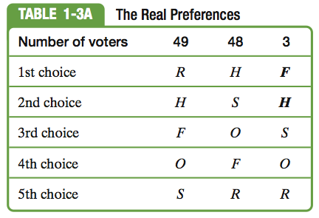
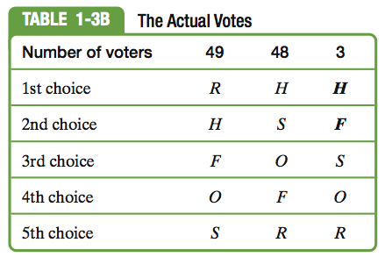
Example 1.4 The Marching Band Election Gets Manipulated

Slide 20
Example 1.4 The Marching Band Election Gets Manipulated
This simple switch by just three voters changes the outcome of the election-the new preference schedule gives 51 votes, and thus the win, to the Hula Bowl.
One of the major flaws of the plurality method: the ease with which election results can be manipulated by a voter or a block of voters through insincere voting.

Slide 21
Consequences of Insincere Voting
Insincere voting common in real-world elections
2000 and 2004 presidential elections: Close races, Ralph Nader lost many votes - voters did not want to “waste their vote.”
Independent and small party candidates never get a fair voice or fair level funding (need 5% of vote to qualify for federal funds)
Entrenched two-party system, often gives voters little real choice

